Slide 1
DR.SNSRCAS, CBE
SUBJECT: CLOUD TECHNOLOGY FUNDAMENTALS
COURSE CODE:21UCA501 UNIT - III
TITLE: Networked identity service classes
YEAR: III SEMESTER 2022-2023 (ODD)

Slide 2
Networked identity service classes
To validate Web sites, transactions, transaction participants, clients, and network services—various forms of identity services—have been deployed on networks.
Ticket or token providing services, certificate servers, and other trust mechanisms all provide identity services that can be pushed outof private networks and into the cloud.

Slide 3
Networked identity service classes
Identity protection is one of the more expensive and complex areas of network computing.
Ticket or token providing services, certificate servers, and other trust mechanisms all provide identity services that can be pushed outof private networks and into the cloud.

Slide 4
If you think about it, requests for information on identity by personnel such as HR, managers, and others; by systems and resources for access requests; as identification for network traffic;
significant percentage of all network traffic is supporting an identification service.
Literally hundreds of messages on a network every minute are checking identity, and every Ethernet packet contains header fields that are used to identify the information it contains.

Slide 5
As systems become even more specialized, it has become increasingly difficult to find the security experts needed to run an ID service.
So Identity as a Service or the related hosted (managed) identity services may be the most valuable and cost effective distributed service types you can subscribe to.
.

Slide 6
Identity as a Service (IDaaS) may include any of the following:
Authentication services (identity verification).
Directory services.
Federated identity.
dentity governance.
Identity and profile management.
Policies, roles, and enforcement.
Provisioning (external policy administration).
Registration.
Risk and event monitoring, including audits.
Single sign-on services (pass-through authentication).

Slide 7
The sharing of any or all of these attributes over a network may be the subject of different government Regulations.
many cases must be protected so that only justifiable parties may have access to the minimal amount that may be disclosed.
This level of access defines called an identity relationship.

Slide 8
Exploring Google Applications
Few companies have had as much impact on their industries as Google has had on the computer industry and on the Internet in particular.
Some companies may have more Internet users or have a stock valuation higher than Google. Apple currently fits that description)

Slide 9
Exploring Google Applications
Google remains both a technology and thought leader for all things Internet.
impact of consumer tracking and targeted advertising, free sourcing applications, and the relentless assault on one knowledge domain after another has had a profound impact on the lives of many people. I call it the Google Effect.

Slide 10
Exploring Google Applications
The bulk of Google’s income comes from the sales of target advertising based on information that Google gathers from your activities associated with your Google account.
In 2009, Google’s revenue was $23.6 billion, and it controlled roughly 65 percent of the search market through its various sites and services

Slide 11
Exploring Google Applications
The company is highly profitable, and that has allowed Google to create a huge infrastructure as well as launch many free cloud-based applications and services
In 2009, Google’s revenue was $23.6 billion, and it controlled roughly 65 percent of the search market through its various sites and services

Slide 12
Exploring Google Applications
These applications are offered mostly on a free usage model that represents Google’s Software as a Service portfolio.
A business model that offers cloud-based services for free that are “good enough” is very compelling.
While Google is slowly growing a subscription business selling these applications to enterprises, its revenue represents only a small but growing part of Google’s current income.

Slide 13
Exploring Google Applications
Google’s cloud computing services falls under two umbrellas. The first and best-known offerings are an extensive set of very popular applications that Google offers to the general public. These applications include Google Docs, Google Health, Picasa, Google Mail, Google Earth, and many more.

Slide 15
Defining Identity as a Service (IDaaS)
The establishment and proof of an identity is a central network function.
An identity service is one that stores the information associated with a digital entity in a form that can be queried and managed for use in electronic transactions.
Identity services have as their core functions: a data store, a query engine, and a policy engine that maintains data integrity.

Slide 16
Defining Identity as a Service (IDaaS)
Distributed transaction systems such as internetworks or cloud computing systems magnify the difficulties faced by identity management systems
exposing a much larger attack surface
Whether it is network traffic protection, privileged resource access, or some other defined right or privilege, the validated authorization of an object based on its identity is the central tenet of secure network design.

Slide 17
Defining Identity as a Service (IDaaS)
In this regard, establishing identity may be seen as the key to obtaining trust and to anything that an object or entity wants to claim ownership of.
. Services that provide digital identity management as a service have been part of internetworked systems from Day One.
The Domain Name Service can run on a private network

Slide 18
Defining Identity as a Service (IDaaS)
The name servers that run the various Internet domains (.COM, .ORG, .EDU, .MIL, .TV, .RU, and so on) are IDaaS servers.
. Services that provide digital identity management as a service have been part of internetworked systems from Day One.
The Domain Name Service can run on a private network

Slide 19
Defining Identity as a Service (IDaaS)
The name servers that run the various Internet domains (.COM, .ORG, .EDU, .MIL, .TV, .RU, and so on) are IDaaS servers.
. Services that provide digital identity management as a service have been part of internetworked systems from Day One.
The Domain Name Service can run on a private network

Slide 20
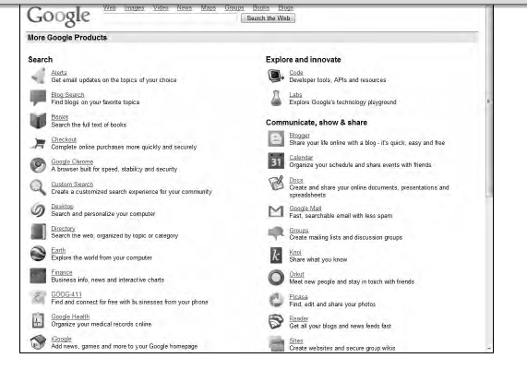

Slide 21
Thank You

